Slide 1


Embarrassingly Parallel with Joblib
Simple parallel computing in Python and some other tools to speed up computing.
Jason Neal
IA Programmers Club
27 May 2016

Slide 2
Purpose:
Discuss what parallel processing is
Embarrassingly parallel with Joblib
Goal:
  Be able to preform parts of our research faster.
Notes:
How many of you know what parallel processing is?
How many of you have implemented it at some stage?

Slide 3
Context:
Needed to fit/optimise/minimise a function that contained a convolution.
1 Convolution would take ~20min to run
Needed to make it faster
Notes:
Context:
Where I am coming from
To give you guys some context I am working on removing the telluric contamination of high resolution spectra to find planetary atmospheres. One part that I was working on this month involved working towards the fitting of a function that scales the H20 lines and then convovles it by the instrumental profile.
To do one convolution on ¼ detectors on my laptop was around 15 minutes. So it was going to take a long time if I was to perform some sort of fit on it. And for the analysis of each star I had.
I wanted to speed it up so I looked how I could parallelise it and found a very simple solution that I though I would share with you all.

Slide 4
Parallel processing
Most (if not all) modern computers are Multicore computers
  e.g. Dual Core (2), Quad Core (4)
  70% idle
Splitting a computation into parts which run in different processes/CPU cores/Threads.
Notes:
Even if you have multiple cores you program or script only uses one. The other cores remain idle or allow you to do other tasks, e.g. browse your social media platform of choice.
But often the processing power of your computer is being wasted while your time is being wasted.

Slide 5
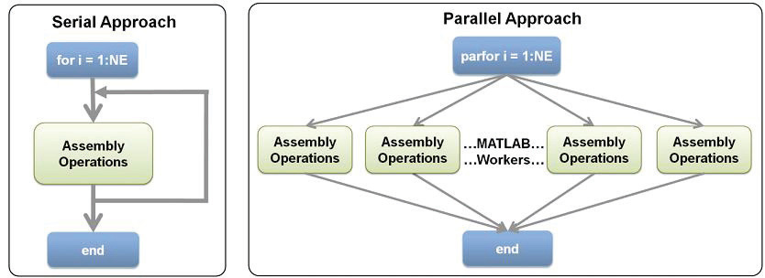
2 types of processing
Serial – sequential, one after another
Parallel – simultaneous, all or many at once.
Notes:
There are two main types of processing Sequential and parallel,
Sequential is what you probably normally do where you do one step after another. In a loop this is where you do the first item , then the second then the third etc.
Parallel processing is different in which the task is split up in to many different jobs, each with a of the tota problem and are run on different cores at the same time.
This diagram is an example from Matlab. In matlab a parallel process can be simply ran using parfor instead of for.

Slide 6
Embarrassingly Parallel (pleasingly parallel)
Where little or no effort is needed to separate the problem into a number of parallel tasks.
little or no
  dependency,
  need for communication between those parallel tasks
  or for results between them
Each iteration is independent.

Slide 7
Joblib
Embarrassingly parallel for loops
  https://pythonhosted.org/joblib/parallel.html
Other main features:
  logging and tracing of the execution
  transparent disk-caching of the output values and lazy re-evaluation (memoize pattern)
    Caches the inputs and outputs of a function
    If it is called with the same inputs then it just returns the result without recalculating it.
    Suitable for large arrays

Slide 8
Installing Joblib
Documentation says use :
  easy_install joblib
I would suggest trying these instead
  conda install joblib
  pip install joblib
  https://pythonhosted.org/joblib/installing.html

Slide 9
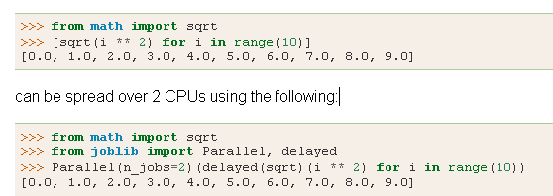
Parallel for loops
Syntax Example
* Not recommended to actually implement this already fast calculation due to overheads.

Slide 10
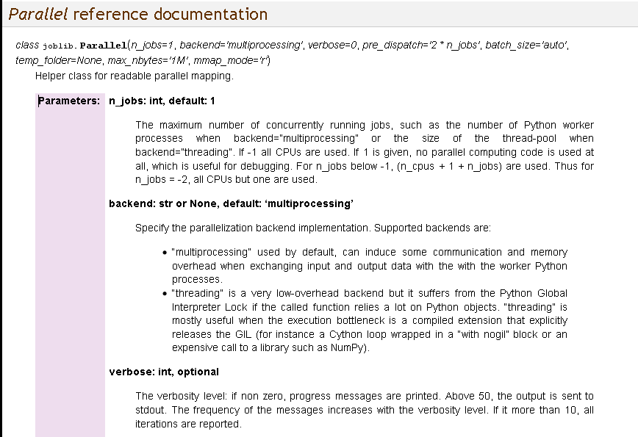

Slide 11
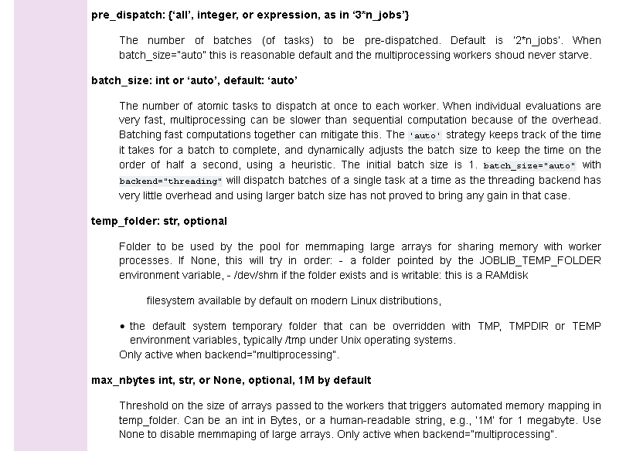

Slide 12
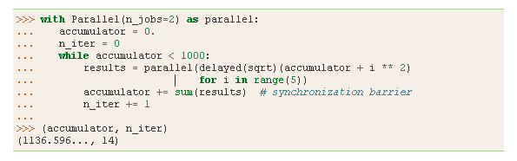
Parallel Issues:
Overheads
  Time to initalize/organize parallel processes
Risk of opening/destroying multiple workers
Memory
  The data given to Parallel is reproduced n_job times.

Slide 13
Memmapping
Shared memory location in a temporary file
Automatic if the array exceeds max_nbytes parameter of Parallel
Can use to manually free up memory space if you have large arrays.

Slide 14
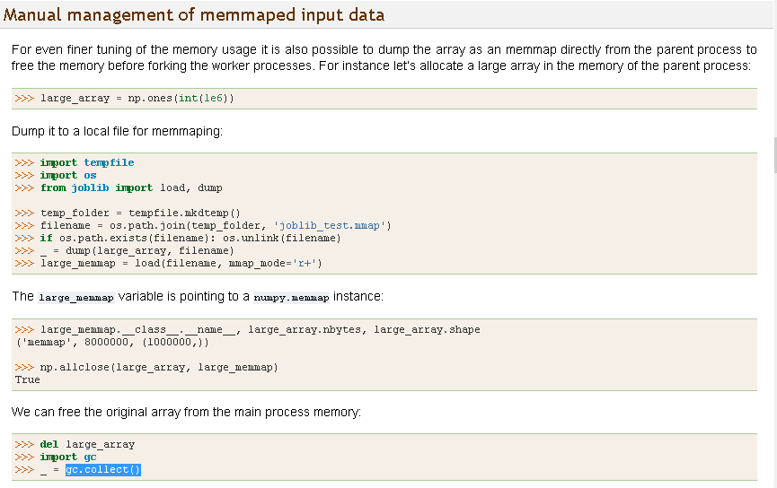

Slide 16
Links
Embarrassingly parallel for loops
  https://pythonhosted.org/joblib/parallel.html
Parallel processing python related libraries
  https://wiki.python.org/moin/ParallelProcessing
Youtube video on Joblib
  https://www.youtube.com/watch?v=nEyYt-CHRZo

